Slide 1
Data Analytics Bootcamp Admissions Task: Qualitative Analysis
By Matthew Pan

Slide 2
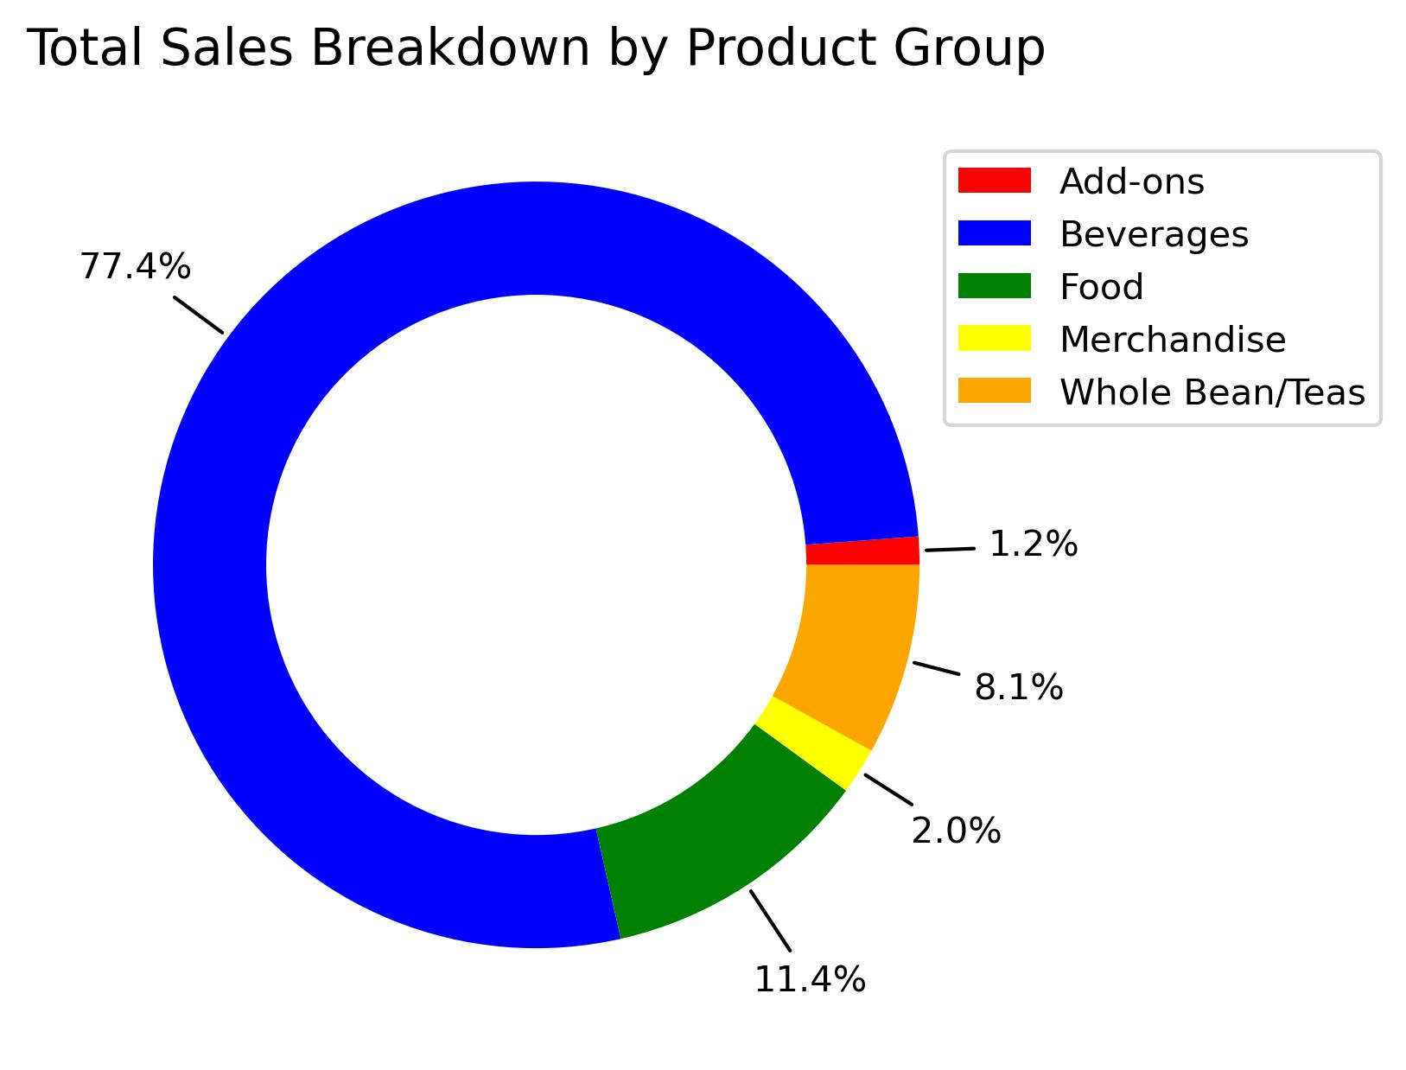
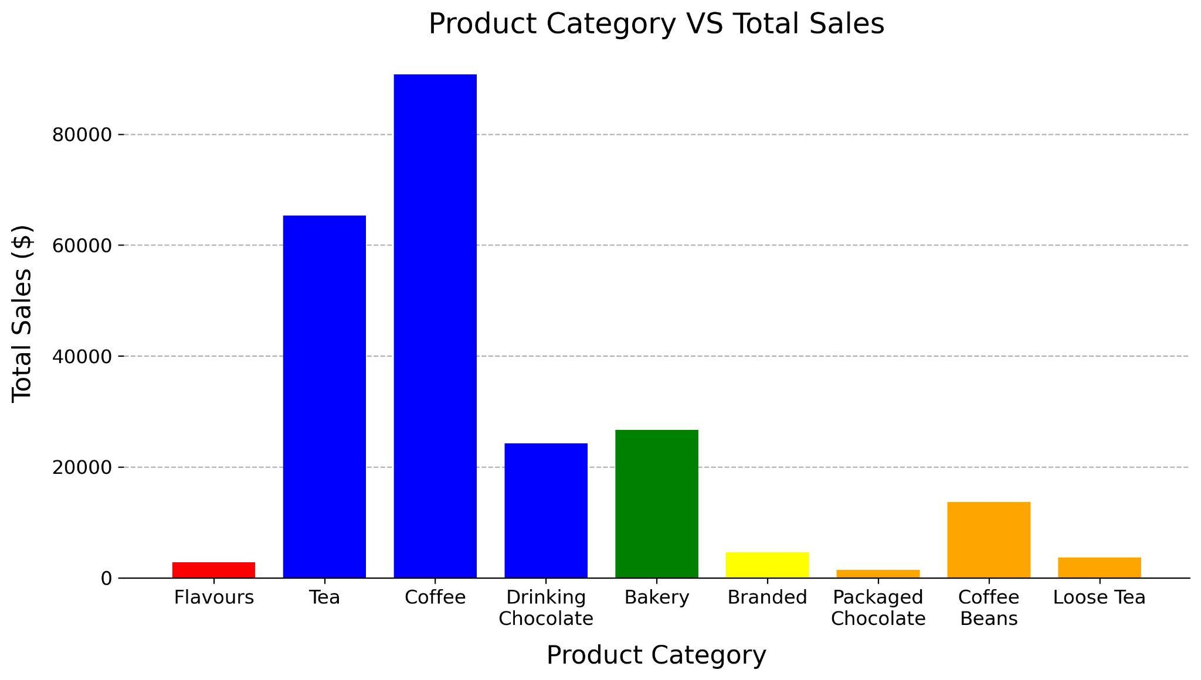
Sales Breakdown By Product Group/Category
38.9%
5.9%
Overall, the product group with highest sales is Beverages at 77.4%
In Beverages, the product category with the highest sales is Coffee at 38.9%.
In Whole Bean/Teas, the product category with the highest sales is Coffee Beans at 5.9%.

Slide 3
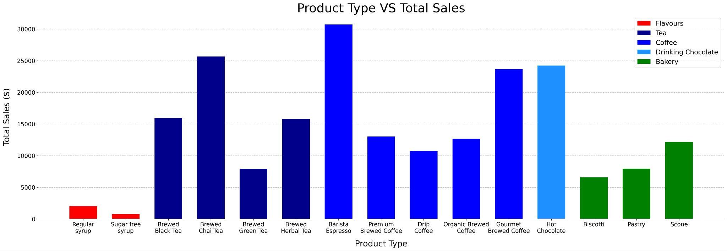
Sales Breakdown By Product Type
13.2%
11.0%
5.2%
In Coffees, the product type with the highest sales is Barista Espresso at 13.2%.
In Teas, the product type with the highest sales is Brewed Chai Tea at 11.0%.
In Bakeries, the product type with the highest sales is Scone at 5.2%.

Slide 4
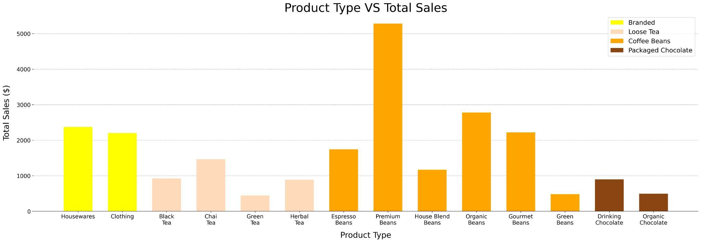
Sales Breakdown By Product Type
2.3%
0.6%
In Coffee Beans, the product type with the highest sales is Premium Beans at 2.3%.
In Loose Teas, the product type with the highest sales is Chai Tea at 0.6%.
Strong preference for Chai Tea amongst tea lovers.

Slide 5
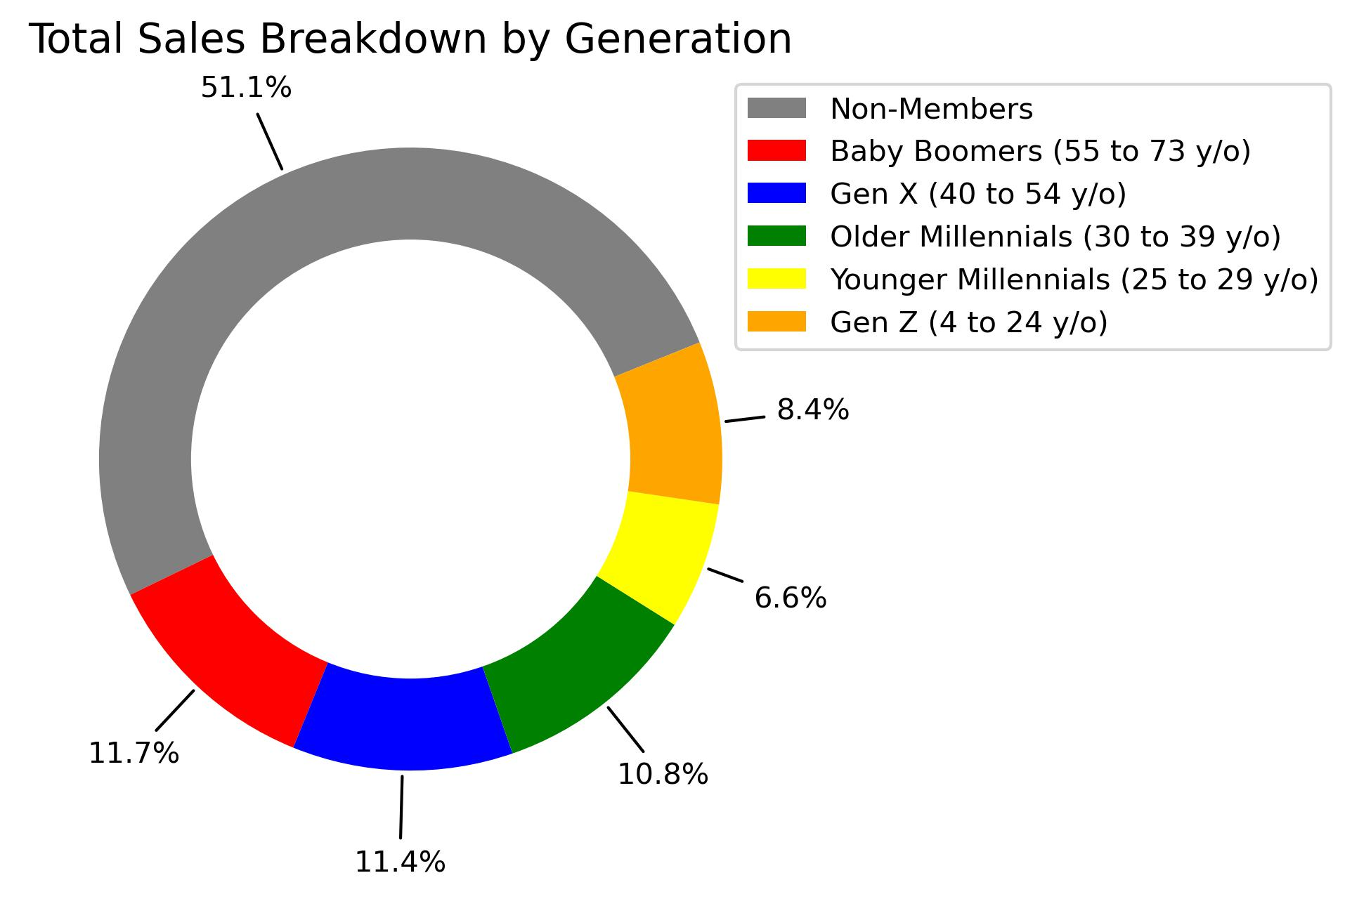
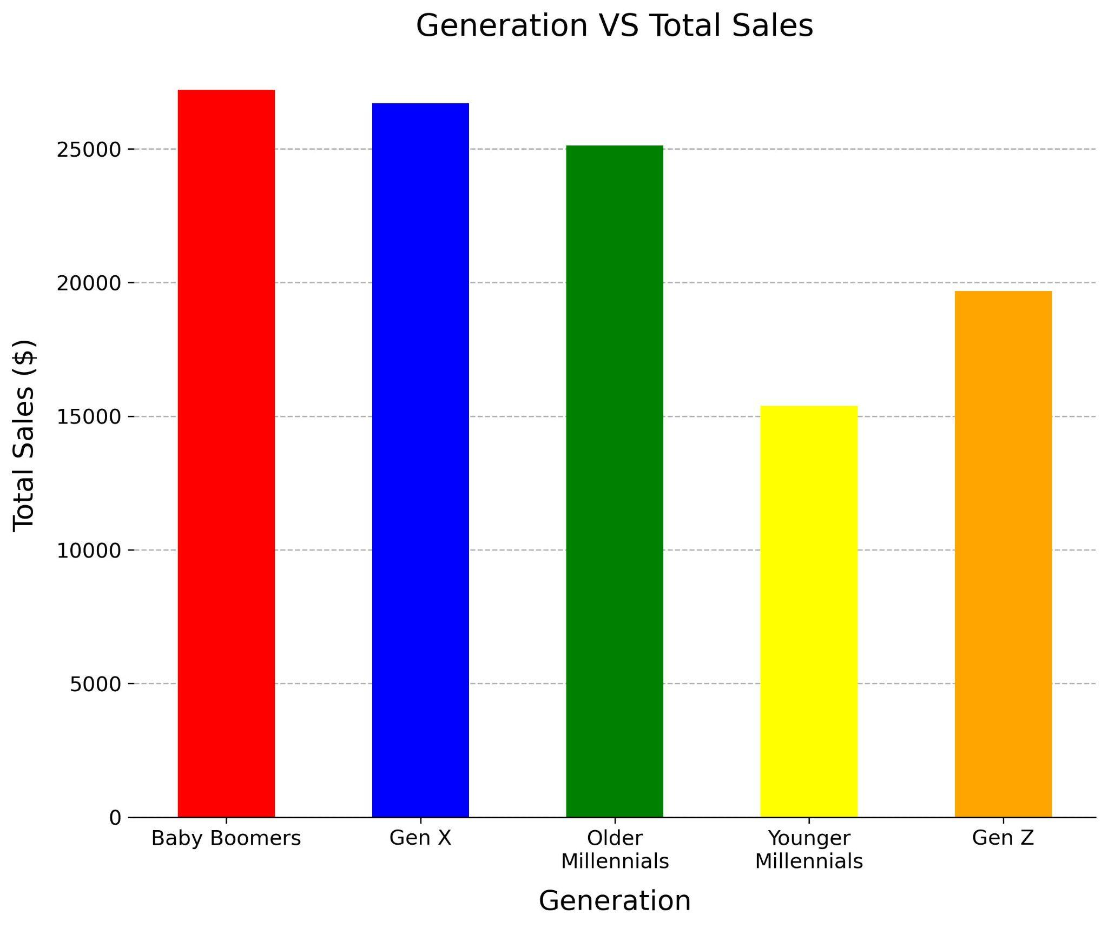
Sales Breakdown By Customers (Generation)
Baby Boomers generate the highest sales amongst loyalty card holders at 11.7%.
Have the most disposable income.
Have more time to frequent coffee shops.

Slide 6
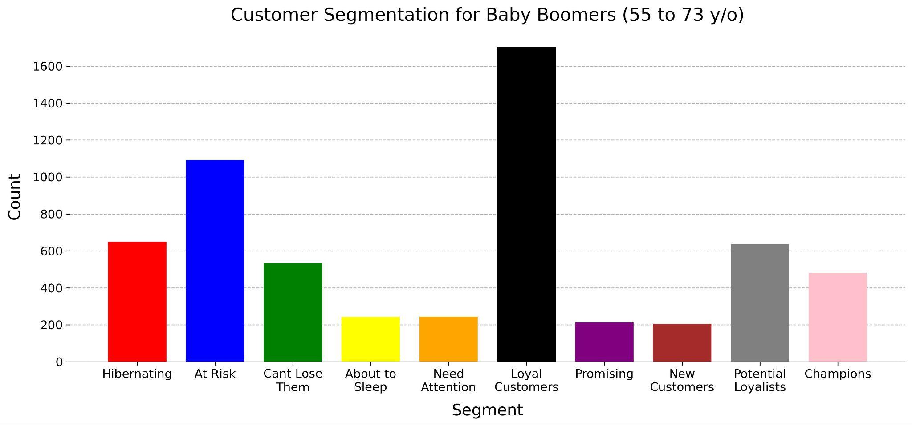
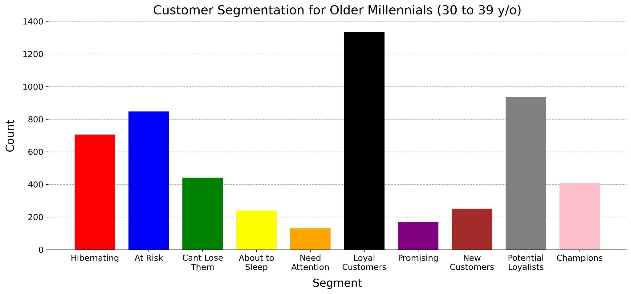
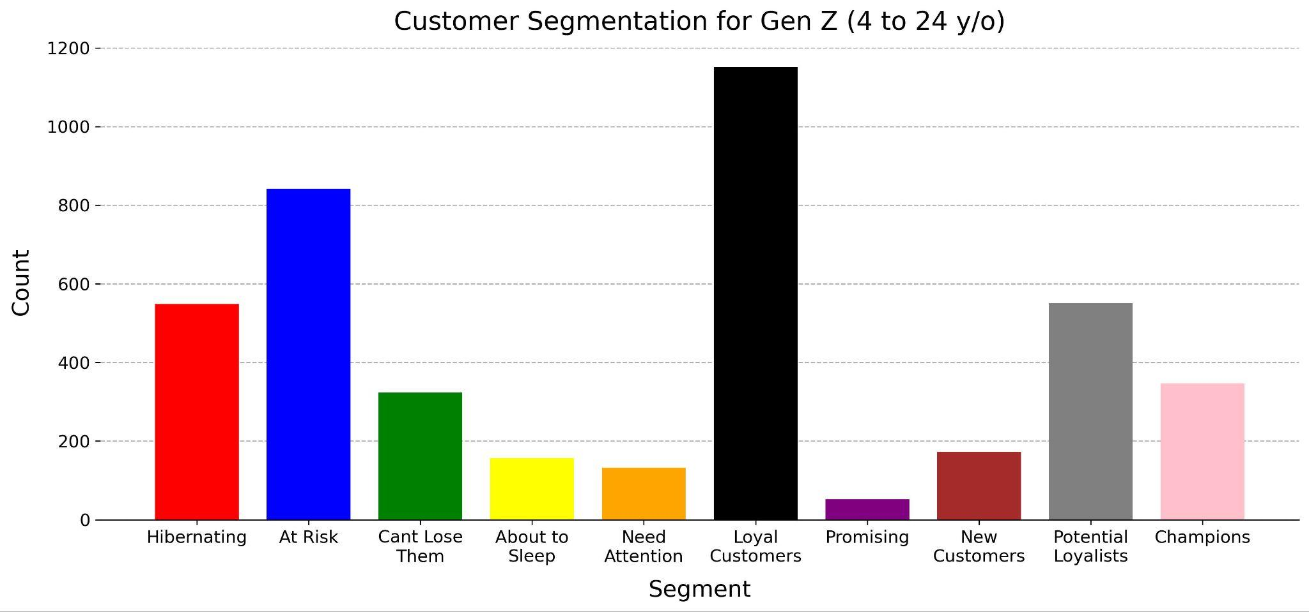
RFM Analysis
28.4%
24.4%
17.1%
18.2%
15.5%
12.9%
10.8%
10.6%
Loyal customers are the largest customer segments for all generations. Baby Boomers being the most loyal at 28.4%.
Fairly large segments of customers are At Risk and Hibernating.
26.9%
19.7%
12.8%
12.9%
Notes:
Champions: Bought recently, buy often and spend the most
Loyal customers: Buy on a regular basis. Responsive to promotions.
Potential loyalist: Recent customers with average frequency.
Recent customers: Bought most recently, but not often.
Promising: Recent shoppers, but haven’t spent much.
Needs attention: Above average recency, frequency and monetary values. May not have bought very recently though.
About to sleep: Below average recency and frequency. Will lose them if not reactivated.
At risk: Some time since they’ve purchased. Need to bring them back!
Can’t lose them: Used to purchase frequently but haven’t returned for a long time.
Hibernating: Last purchase was long back and low number of orders. May be lost.

Slide 7
Recommendation
Marketing campaign targeting the highest sale segment:
Such as the Baby Boomers and Gen X customers, specifically focusing on segments that are Loyal Customers.
Coffee lovers who purchase Barista Espresso and Premium Beans
Maximize profits quickly due to higher ROI.
Build loyalty and nurture VIP.
Marketing campaign targeting the lowest sale segment:
Such as the Younger Millennials and Gen Z customers, specifically focusing on segments that are At Risk or Hibernating.
Drinking or Packaged Chocolate consumers
High growth potential, good for increasing overall market share
Good market for launching a new or budget-friendly product.

Slide 8
Further Analysis
Deeper analysis into total sales of products factoring in unit price, no. of transactions, and unique product brands.
Correlation analysis between product group and generation to discover the relationship between the 2 variables.
Profit margin of products factoring in wholesale and retail price.
Calculate the Customer Lifetime Value (CLTV) to predict the total revenue a single customer will generate over the course of their relationship with the business.
Microeconomic analysis factoring in price elasticity of products, a more unique brand will be more suitable for price increases /w less than proportionate drop in demand, leading to increase in revenue.

Slide 9

Q & A
THANK YOU FOR YOUR TIME!

